Slide 1
CSE322
Formal Languages and Automation Theory
Unit 1 : Finite Automata

Slide 2
FSM :Finite State Machine )
A finite-state machine (FSM) or finite-state automaton (plural: automata), or simply a state machine, is a mathematical model of computation
It is used to design both computer programs and sequential logic circuits. It is conceived as an abstract machine that can be in one of a finite number of states.
The machine is in only one state at a time; the state it is in at any given time is called the current state.
It can change from one state to another when initiated by a triggering event or condition, this is called a transition.
A particular FSM is defined by a list of its states, and the triggering condition for each transition.
Notes:
Cpt S 317: Spring 2009
School of EECS, WSU

Slide 3
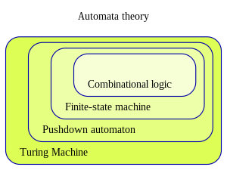
Classes of Automata

Slide 4
Finite Automaton
Input
String
Output
“Accept”
or
“Reject”
Finite
Automaton

Slide 5
Formal Definition of FA
A Deterministic Finite Automaton (DFA) consists of:
  Q ==> a finite set of states
  ∑ ==> a finite set of input symbols (alphabet)
  q₀ ==> a start state
  F ==> set of accepting states
  δ ==> a transition function, which is a mapping between Q x ∑ ==> Q
A DFA is defined by the 5-tuple:
  {Q, ∑ , q₀,F, δ }
Notes:
Cpt S 317: Spring 2009
School of EECS, WSU

Slide 6
What does a DFA do on reading an input string?
Input: a word w in ∑*
Question: Is w acceptable by the DFA?
Steps:
  Start at the “start state” q₀
  For every input symbol in the sequence w do
    Compute the next state from the current state, given the current input symbol in w and the transition function
  If after all symbols in w are consumed, the current state is one of the accepting states (F) then accept w;
  Otherwise, reject w.
Notes:
Cpt S 317: Spring 2009
School of EECS, WSU

Slide 7
Regular Languages
Let L(A) be a language recognized by a DFA A.
  Then L(A) is called a “Regular Language”.
Locate regular languages in the Chomsky Hierarchy
Notes:
Cpt S 317: Spring 2009
School of EECS, WSU

Slide 8
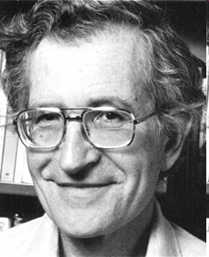
The Chomsky Hierachy
A containment hierarchy of classes of formal languages
Recursively-
enumerable
(TM)
Context-
sensitive
(LBA)
Context-
free
(PDA)
Regular
(DFA)
Notes:
Cpt S 317: Spring 2009
School of EECS, WSU

Slide 9
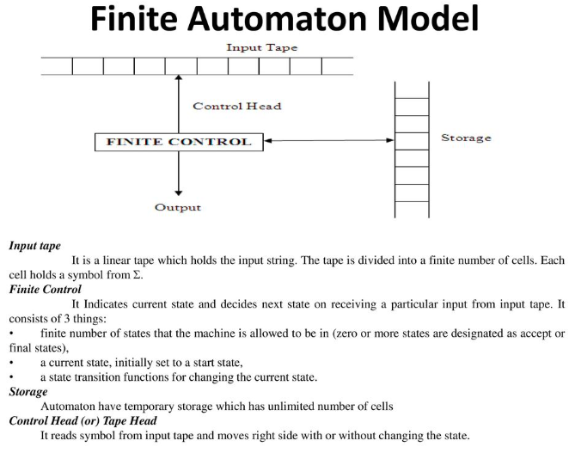

Slide 10
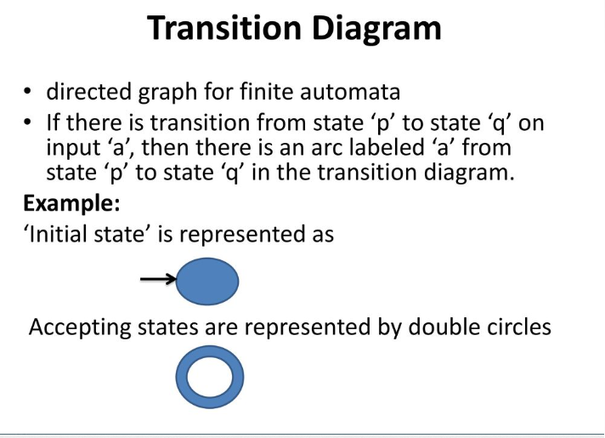
Representation methods of FA

Slide 11









Representation Method :Transition Graph
initial
state
accepting
state
transition
state

Slide 12
Transition Table
The transition table is basically a tabular representation of the transition function. It takes two arguments (a state and a symbol) and returns a state (the "next state").
A transition table is represented by the following things:
Columns correspond to input symbols.
Rows correspond to states.
Entries correspond to the next state.
The start state is denoted by an arrow with no source.
The accept state is denoted by a star.

Slide 13
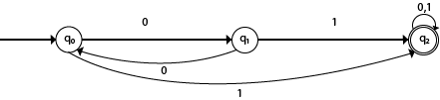
Transition Table

Slide 14
Transition Table
Present State | Next state for Input 0 | Next State of Input 1
→q0 | q1 | q2
q1 | q0 | q2
*q2 | q2 | q2

Slide 15
Transition Graph
initial
state
accepting
state
transition
state

Slide 16
Initial Configuration
Input String

Slide 17
Reading the Input

Slide 21
Input finished
accept

Slide 22
Rejection

Slide 26
Input finished
reject

Slide 27
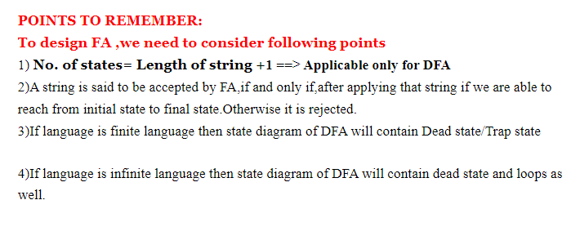
Designing of the DFA

Slide 28
Example #1
Build a DFA for the following language:
  L = {w | w is a binary string that contains 01 as a substring}
Steps for building a DFA to recognize L:
  ∑ = {0,1}
  Decide on the states: Q
  Designate start state and final state(s)
  δ: Decide on the transitions:
“Final” states == same as “accepting states”
Other states == same as “non-accepting states”
Notes:
Cpt S 317: Spring 2009
School of EECS, WSU

Slide 29
DFA for strings containing 01
What makes this DFA deterministic?
Q = {q₀,q₁,q₂}
∑ = {0,1}
start state = q₀
F = {q₂}
Transition table
1
0
0,1
start
0
1
q₀
q₁
q₂
Accepting
state
symbols
0
1
q₀
q₁
q₀
What if the language allows
empty strings?
q₁
q₁
q₂
states
*q₂
q₂
q₂
Notes:
Cpt S 317: Spring 2009
School of EECS, WSU

Slide 30
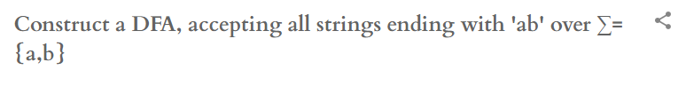
Example #2
Notes:
Cpt S 317: Spring 2009
School of EECS, WSU

Slide 31
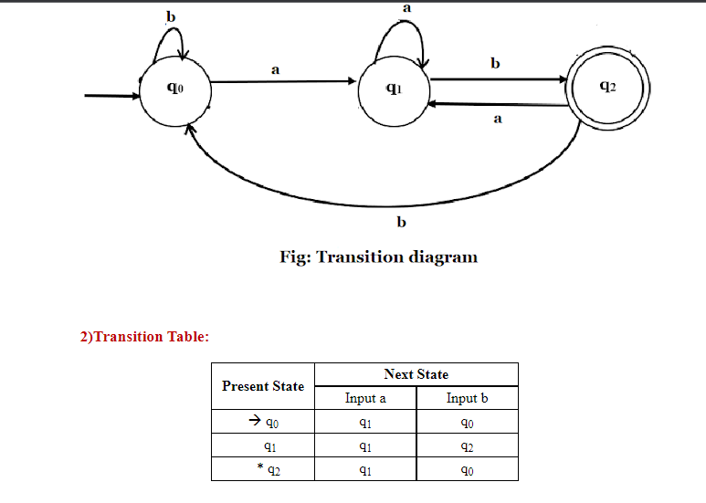

Slide 32
Example #3
Build a DFA for the following language:
L = { w | w is a binary string that has even number of 1s and even number of 0s}
?
Notes:
Cpt S 317: Spring 2009
School of EECS, WSU

Slide 33
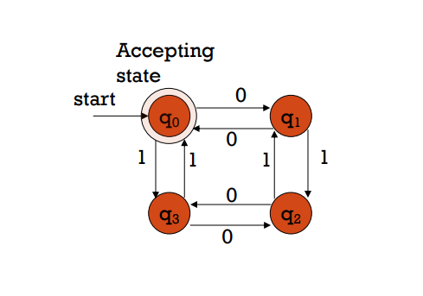

Slide 34

Example # 4:

Slide 35
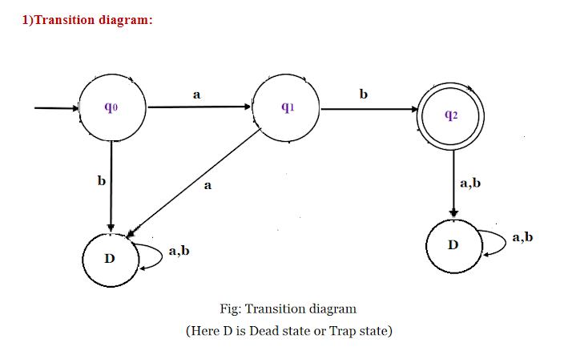
Example # 4: Solution :

Slide 36
Language of a DFA
A DFA A accepts string w if there is a path from q₀ to an accepting (or final) state that is labeled by w
i.e., L(A) = { w | δ(q₀,w) ∈ F }
I.e., L(A) = all strings that lead to an accepting state from q₀
Notes:
Cpt S 317: Spring 2009
School of EECS, WSU

Slide 37
Non-deterministic Finite Automata (NFA)
A Non-deterministic Finite Automaton (NFA)
  is of course “non-deterministic”
    Implying that the machine can exist in more than one state at the same time
    Transitions could be non-deterministic
1
q_{j}
q_{i}
…
Each transition function therefore
maps to a set of states
1
q_{k}
Notes:
Cpt S 317: Spring 2009
School of EECS, WSU

Slide 38
Non-deterministic Finite Automata (NFA)
A Non-deterministic Finite Automaton (NFA) consists of:
  Q ==> a finite set of states
  ∑ ==> a finite set of input symbols (alphabet)
  q₀ ==> a start state
  F ==> set of accepting states
  δ ==> a transition function, which is a mapping between Q x ∑ ==> subset of Q
An NFA is also defined by the 5-tuple:
  {Q, ∑ , q₀,F, δ }
Notes:
Cpt S 317: Spring 2009
School of EECS, WSU

Slide 39
How to use an NFA?
Input: a word w in ∑*
Question: Is w acceptable by the NFA?
Steps:
  Start at the “start state” q₀
  For every input symbol in the sequence w do
    Determine all possible next states from all current states, given the current input symbol in w and the transition function
  If after all symbols in w are consumed and if at least one of the current states is a final state then accept w;
  Otherwise, reject w.
Notes:
Cpt S 317: Spring 2009
School of EECS, WSU

Slide 40
NFA for strings containing 01
Regular expression: (0+1)*01(0+1)*
Why is this non-deterministic?
Q = {q₀,q₁,q₂}
Σ = {0,1}
start state = q₀
F = {q₂}
Transition table
0,1
0,1
start
0
1
q₀
q₁
q₂
Final
state
symbols
0
1
What will happen if at state q₁
an input of 0 is received?
q₀
{q₀,q₁}
{q₀}
states
q₁
Φ
{q₂}
*q₂
{q₂}
{q₂}
Notes:
Cpt S 317: Spring 2009
School of EECS, WSU

Slide 41
What is an “error state”?
Note: Omitting to explicitly show error states is just a matter of design convenience
(one that is generally followed for NFAs), and
i.e., this feature should not be confused with the notion of non-determinism.
A DFA for recognizing the key word “while”
An NFA for the same purpose:
w
h
i
l
e
q₀
q₁
q₂
q₃
q₄
q₅
Any other input symbol
q_{err}
Any symbol
w
h
i
l
e
q₀
q₁
q₂
q₃
q₄
q₅
Transitions into a dead state are implicit
Notes:
Cpt S 317: Spring 2009
School of EECS, WSU

Slide 42
Example #2
Build an NFA for the following language:
L = { w | w ends in 01}
?
Other examples
  Keyword recognizer (e.g., if, then, else, while, for, include, etc.)
  Strings where the first symbol is present somewhere later on at least once
Notes:
Cpt S 317: Spring 2009
School of EECS, WSU

Slide 43
Extension of δ to NFA Paths
Basis: δ (q,ε) = {q}
Induction:
  Let δ (q₀,w) = {p₁,p₂…,p_{k}}
  δ (p_{i},a) = S_{i} for i=1,2...,k
  Then, δ (q₀,wa) = S₁ U S₂ U … U S_{k}
Notes:
Cpt S 317: Spring 2009
School of EECS, WSU

Slide 44
Language of an NFA
An NFA accepts w if there exists at least one path from the start state to an accepting (or final) state that is labeled by w
L(N) = { w | δ(q₀,w) ∩ F ≠ Φ }
Notes:
Cpt S 317: Spring 2009
School of EECS, WSU

Slide 45
Advantages & Caveats for NFA
Great for modeling regular expressions
  String processing - e.g., grep, lexical analyzer
Could a non-deterministic state machine be implemented in practice?
  Probabilistic models could be viewed as extensions of non-deterministic state machines
  (e.g., toss of a coin, a roll of dice)
    They are not the same though
  A parallel computer could exist in multiple “states” at the same time
Notes:
Cpt S 317: Spring 2009
School of EECS, WSU

Slide 46
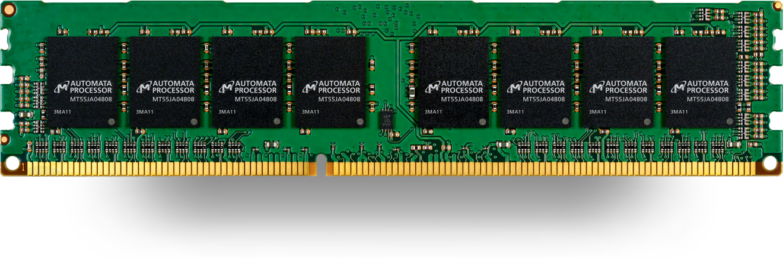
Technologies for NFAs
Micron’s Automata Processor (introduced in 2013)
2D array of MISD (multiple instruction single data) fabric w/ thousands to millions of processing elements.
1 input symbol = fed to all states (i.e., cores)
Non-determinism using circuits
http://www.micronautomata.com/

Slide 47
Differences: DFA vs. NFA
But, DFAs and NFAs are equivalent in their power to capture langauges !!
DFA
All transitions are deterministic
  Each transition leads to exactly one state
For each state, transition on all possible symbols (alphabet) should be defined
Accepts input if the last state visited is in F
Sometimes harder to construct because of the number of states
Practical implementation is feasible
NFA
Some transitions could be non-deterministic
  A transition could lead to a subset of states
Not all symbol transitions need to be defined explicitly (if undefined will go to an error state – this is just a design convenience, not to be confused with “non-determinism”)
Accepts input if one of the last states is in F
Generally easier than a DFA to construct
Practical implementations limited but emerging (e.g., Micron automata processor)
Notes:
Cpt S 317: Spring 2009
School of EECS, WSU

Slide 48
Equivalence of DFA & NFA
Theorem:
  A language L is accepted by a DFA if and only if it is accepted by an NFA.
Proof:
  If part:
    Prove by showing every NFA can be converted to an equivalent DFA (in the next few slides…)
  Only-if part is trivial:
    Every DFA is a special case of an NFA where each state has exactly one transition for every input symbol. Therefore, if L is accepted by a DFA, it is accepted by a corresponding NFA.
Should be true for any L
Notes:
Cpt S 317: Spring 2009
School of EECS, WSU

Slide 49
Proof for the if-part
If-part: A language L is accepted by a DFA if it is accepted by an NFA
rephrasing…
Given any NFA N, we can construct a DFA D such that L(N)=L(D)
How to convert an NFA into a DFA?
  Observation: In an NFA, each transition maps to a subset of states
  Idea: Represent:
  each “subset of NFA_states” ➔ a single “DFA_state”
Subset construction
Notes:
Cpt S 317: Spring 2009
School of EECS, WSU

Slide 50
NFA to DFA by subset construction
Let N = {Q_{N},∑,δ_{N},q₀,F_{N}}
Goal: Build D={Q_{D},∑,δ_{D},{q₀},F_{D}} s.t. L(D)=L(N)
Construction:
  Q_{D}= all subsets of Q_{N} (i.e., power set)
  F_{D}=set of subsets S of Q_{N} s.t. S∩F_{N}≠Φ
  δ_{D}: for each subset S of Q_{N} and for each input symbol a in ∑:
    δ_{D}(S,a) = U δ_{N}(p,a)
p in s
Notes:
Cpt S 317: Spring 2009
School of EECS, WSU

Slide 51
NFA to DFA construction: Example
Idea: To avoid enumerating all of
power set, do
“lazy creation of states”
L = {w | w ends in 01}
1
0
NFA:
DFA:
[q₀]
0
[q₀,q₁]
1
[q₀,q₂]
0,1
0
0
1
1
q₀
q₁
q₂
δ_{D} | 0 | 1
Ø | Ø | Ø
[q₀] | {q₀,q₁} | {q₀}
[q₁] | Ø | {q₂}
*[q₂] | Ø | Ø
[q₀,q₁] | {q₀,q₁} | {q₀,q₂}
*[q₀,q₂] | {q₀,q₁} | {q₀}
*[q₁,q₂] | Ø | {q₂}
*[q₀,q₁,q₂] | {q₀,q₁} | {q₀,q₂}
δ_{D} | 0 | 1
[q₀] | [q₀,q₁] | [q₀]
[q₀,q₁] | [q₀,q₁] | [q₀,q₂]
*[q₀,q₂] | [q₀,q₁] | [q₀]
δ_{N} | 0 | 1
q₀ | {q₀,q₁} | {q₀}
q₁ | Ø | {q₂}
*q₂ | Ø | Ø
0. Enumerate all possible subsets
Determine transitions
2. Retain only those states
reachable from {q₀}
Notes:
Cpt S 317: Spring 2009
School of EECS, WSU

Slide 52
NFA to DFA: Repeating the example using LAZY CREATION
L = {w | w ends in 01}
1
0
NFA:
DFA:
[q₀]
0
[q₀,q₁]
1
[q₀,q₂]
0,1
0
0
1
1
q₀
q₁
q₂
δ_{N} | 0 | 1
q₀ | {q₀,q₁} | {q₀}
q₁ | Ø | {q₂}
*q₂ | Ø | Ø
δ_{D} | 0 | 1
[q₀] | [q₀,q₁] | [q₀]
[q₀,q₁] | [q₀,q₁] | [q₀,q₂]
*[q₀,q₂] | [q₀,q₁] | [q₀]
Main Idea:
Introduce states as you go
(on a need basis)
Notes:
Cpt S 317: Spring 2009
School of EECS, WSU

Slide 53
Correctness of subset construction
Theorem: If D is the DFA constructed from NFA N by subset construction, then L(D)=L(N)
Proof:
  Show that δ_{D}({q₀},w) ≡ δ_{N}(q₀,w} , for all w
  Using induction on w’s length:
    Let w = xa
    δ_{D}({q₀},xa) ≡ δ_{D}( δ_{N}(q₀,x}, a ) ≡ δ_{N}(q₀,w}
Notes:
Cpt S 317: Spring 2009
School of EECS, WSU

Slide 54
A bad case where #states(DFA)>>#states(NFA)
L = {w | w is a binary string s.t., the k^{th} symbol from its end is a 1}
  NFA has k+1 states
  But an equivalent DFA needs to have at least 2^{k} states
(Pigeon hole principle)
  m holes and >m pigeons
    => at least one hole has to contain two or more pigeons
Notes:
Cpt S 317: Spring 2009
School of EECS, WSU

Slide 55
Applications
Text indexing
  inverted indexing
  For each unique word in the database, store all locations that contain it using an NFA or a DFA
Find pattern P in text T
  Example: Google querying
Extensions of this idea:
  PATRICIA tree, suffix tree
Notes:
Cpt S 317: Spring 2009
School of EECS, WSU

Slide 56
A few subtle properties of DFAs and NFAs
The machine never really terminates.
  It is always waiting for the next input symbol or making transitions.
The machine decides when to consume the next symbol from the input and when to ignore it.
  (but the machine can never skip a symbol)
=> A transition can happen even without really consuming an input symbol (think of consuming ε as a free token) – if this happens, then it becomes an ε-NFA (see next few slides).
A single transition cannot consume more than one (non-ε) symbol.

Slide 57
FA with ε-Transitions
We can allow explicit ε-transitions in finite automata
  i.e., a transition from one state to another state without consuming any additional input symbol
  Explicit ε-transitions between different states introduce non-determinism.
  Makes it easier sometimes to construct NFAs
Definition: ε -NFAs are those NFAs with at least one explicit ε-transition defined.
ε -NFAs have one more column in their transition table
Notes:
Cpt S 317: Spring 2009
School of EECS, WSU

Slide 58
Example of an ε-NFA
L = {w | w is empty, or if non-empty will end in 01}
0,1
ε-closure of a state q, ECLOSE(q), is the set of all states (including itself) that can be reached from q by repeatedly making an arbitrary number of ε-transitions.
q₀
0
q₁
1
q₂
ε
start
q’₀
δ_{E} | 0 | 1 | ε
*q’₀ | Ø | Ø | {q’₀,q₀}
q₀ | {q₀,q₁} | {q₀} | {q₀}
q₁ | Ø | {q₂} | {q₁}
*q₂ | Ø | Ø | {q₂}
ECLOSE(q’₀)
ECLOSE(q₀)
ECLOSE(q₁)
ECLOSE(q₂)
Notes:
Cpt S 317: Spring 2009
School of EECS, WSU

Slide 59
Example of an ε-NFA
To simulate any transition:
Step 1) Go to all immediate destination states.
Step 2) From there go to all their ε-closure states as well.
L = {w | w is empty, or if non-empty will end in 01}
0,1
Simulate for w=101:
q₀
0
q₁
1
q₂
ε
q₀’
start
ε
ε
q’₀
q₀’
q₀
1
1
δ_{E} | 0 | 1 | ε
*q’₀ | Ø | Ø | {q’₀,q₀}
q₀ | {q₀,q₁} | {q₀} | {q₀}
q₁ | Ø | {q₂} | {q₁}
*q₂ | Ø | Ø | {q₂}
Ø
q₀
x
0
ECLOSE(q’₀)
q₁
ECLOSE(q₀)
1
q₂
Notes:
Cpt S 317: Spring 2009
School of EECS, WSU

Slide 60
Example of another ε-NFA
To simulate any transition:
Step 1) Go to all immediate destination states.
Step 2) From there go to all their ε-closure states as well.
0,1
Simulate for w=101:
?
q₀
0
q₁
1
q₂
ε
ε
1
start
q’₀
q₃
δ_{E} | 0 | 1 | ε
*q’₀ | Ø | Ø | {q’₀,q₀,q₃}
q₀ | {q₀,q₁} | {q₀} | {q_{0,}q₃}
q₁ | Ø | {q₂} | {q₁}
*q₂ | Ø | Ø | {q₂}
q₃ | Ø | {q₂} | {q₃}
Notes:
Cpt S 317: Spring 2009
School of EECS, WSU

Slide 61
Equivalency of DFA, NFA, ε-NFA
Theorem: A language L is accepted by some ε-NFA if and only if L is accepted by some DFA
Implication:
  DFA ≡ NFA ≡ ε-NFA
  (all accept Regular Languages)
Notes:
Cpt S 317: Spring 2009
School of EECS, WSU

Slide 62
Eliminating ε-transitions
Let E = {Q_{E},∑,δ_{E},q₀,F_{E}} be an ε-NFA
Goal: To build DFA D={Q_{D},∑,δ_{D},{q_{D}},F_{D}} s.t. L(D)=L(E)
Construction:
  Q_{D}= all reachable subsets of Q_{E} factoring in ε-closures
  q_{D} = ECLOSE(q₀)
  F_{D}=subsets S in Q_{D} s.t. S∩F_{E}≠Φ
  δ_{D}: for each subset S of Q_{E} and for each input symbol a∈∑:
    Let R= U δ_{E}(p,a) // go to destination states
    δ_{D}(S,a) = U ECLOSE(r) // from there, take a union
    of all their ε-closures
p in s
r in R
Reading: Section 2.5.5 in book
Notes:
Cpt S 317: Spring 2009
School of EECS, WSU

Slide 63
Example: ε-NFA ➔ DFA
L = {w | w is empty, or if non-empty will end in 01}
0,1
q₀
0
q₁
1
q₂
ε
start
q’₀
δ_{E} | 0 | 1 | ε
*q’₀ | Ø | Ø | {q’₀,q₀}
q₀ | {q₀,q₁} | {q₀} | {q₀}
q₁ | Ø | {q₂} | {q₁}
*q₂ | Ø | Ø | {q₂}
δ_{D} | 0 | 1
*{q’₀,q₀}
…
Notes:
Cpt S 317: Spring 2009
School of EECS, WSU

Slide 64
Example: ε-NFA ➔ DFA
L = {w | w is empty, or if non-empty will end in 01}
0,1
0
{q₀,q₁}
0
0
1
{q₀,q₂}
q₀
q₁
q₂
0
1
ε
0
{q’₀, q₀}
1
start
start
1
q’₀
q₀
1
ECLOSE
union
δ_{E} | 0 | 1 | ε
*q’₀ | Ø | Ø | {q’₀,q₀}
q₀ | {q₀,q₁} | {q₀} | {q₀}
q₁ | Ø | {q₂} | {q₁}
*q₂ | Ø | Ø | {q₂}
δ_{D} | 0 | 1
*{q’₀,q₀} | {q₀,q₁} | {q₀}
{q₀,q₁} | {q₀,q₁} | {q₀,q₂}
{q₀} | {q₀,q₁} | {q₀}
*{q₀,q₂} | {q₀,q₁} | {q₀}
Notes:
Cpt S 317: Spring 2009
School of EECS, WSU

Slide 65
Summary
DFA
  Definition
  Transition diagrams & tables
Regular language
NFA
  Definition
  Transition diagrams & tables
DFA vs. NFA
NFA to DFA conversion using subset construction
Equivalency of DFA & NFA
Removal of redundant states and including dead states
ε-transitions in NFA
Pigeon hole principles
Text searching applications
Notes:
Cpt S 317: Spring 2009
School of EECS, WSU

